Slide 1
FINANCIAL ANALYSIS OF DIVIS LABORATORIES
Submitted to :
Prof. Gopinathan N

Slide 2
Aryan Bansal (20BCE1591)
Arnab Mondal (20BCE1294)
Ajay Rajkumar (20BAI1020)
Team members
Dharani R (20BCE1897)
Govind Agarwal (20BCE1618)
Kritika Jindal (20BCE1913)

Slide 3
01
Income Statement
02
Balance Sheet
Table of contents
03
Cash Flow
04
Market Capitalisation

Slide 4

01
INCOME STATEMENT

Slide 5

INCOME STATEMENT
An income statement or profit and loss account is one of the financial statements of a company and shows the company's revenues and expenses during a particular period. It indicates how the revenues are transformed into the net income or net profit.

Slide 6
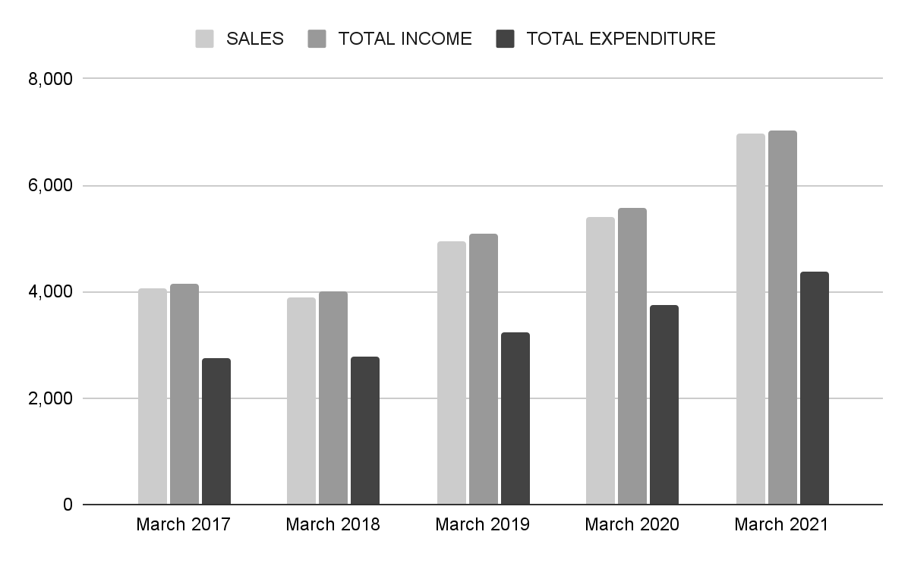
SALES vs TOTAL INCOME vs TOTAL EXPENDITURE

Slide 7
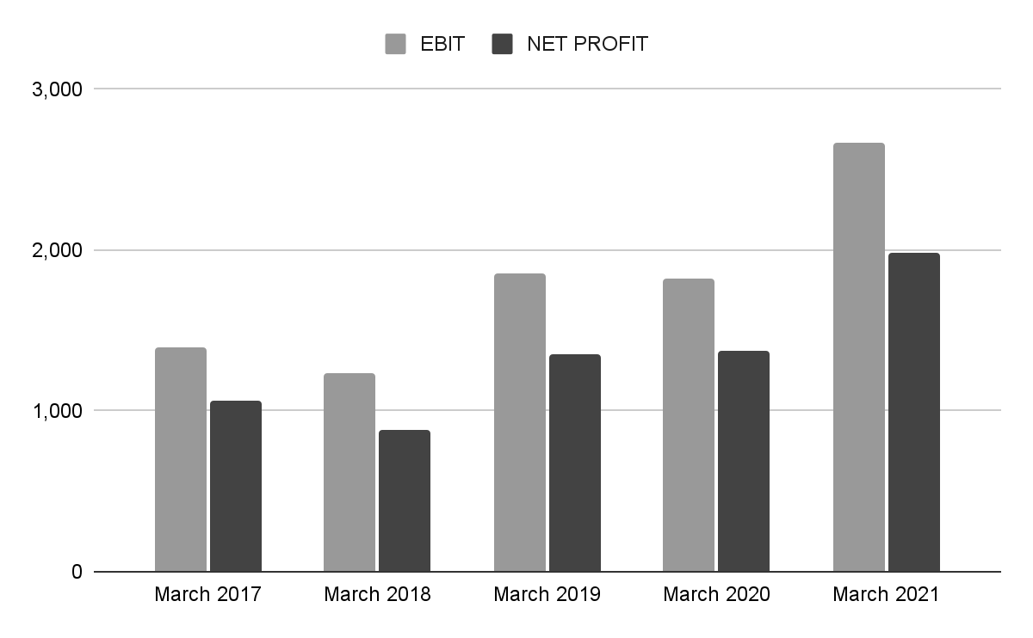
EBIT vs NET PROFIT

Slide 8

02
BALANCE SHEET

Slide 9

BALANCE SHEET
A balance sheet is a financial statement that reports a company's assets, liabilities, and shareholder equity. The balance sheet is one of the three core financial statements that are used to evaluate a business. It provides a snapshot of a company's finances (what it owns and owes) as of the date of publication.

Slide 10
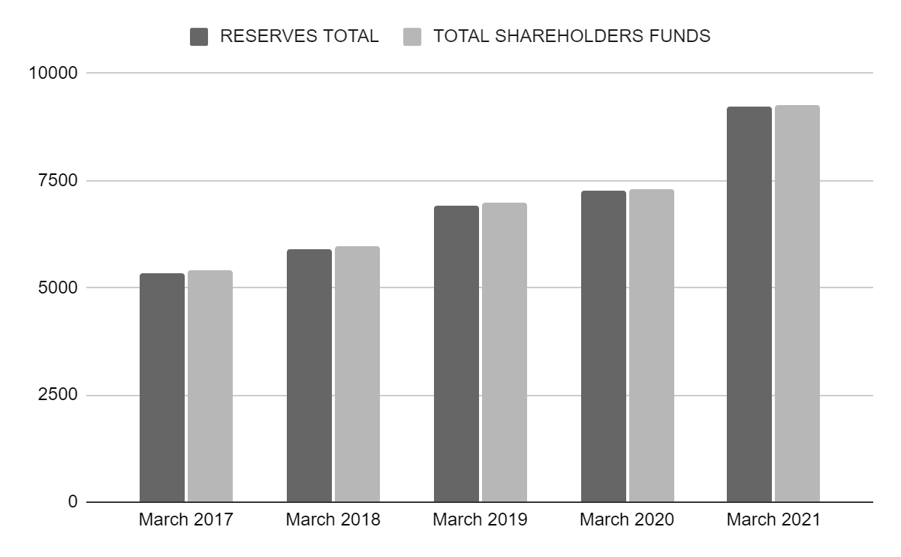
RESERVES TOTAL VS shareholder funds

Slide 11
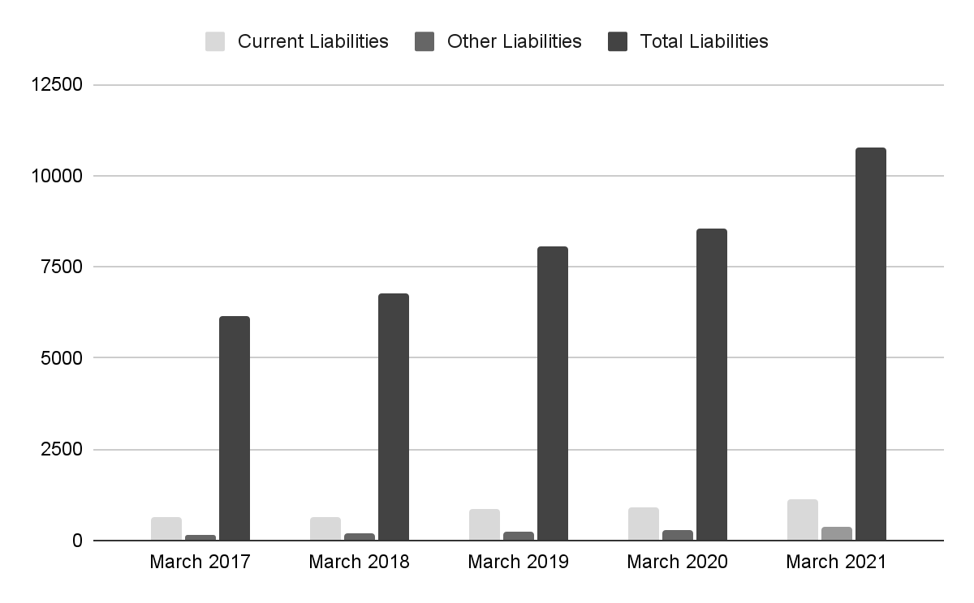
LIABILITIES

Slide 12
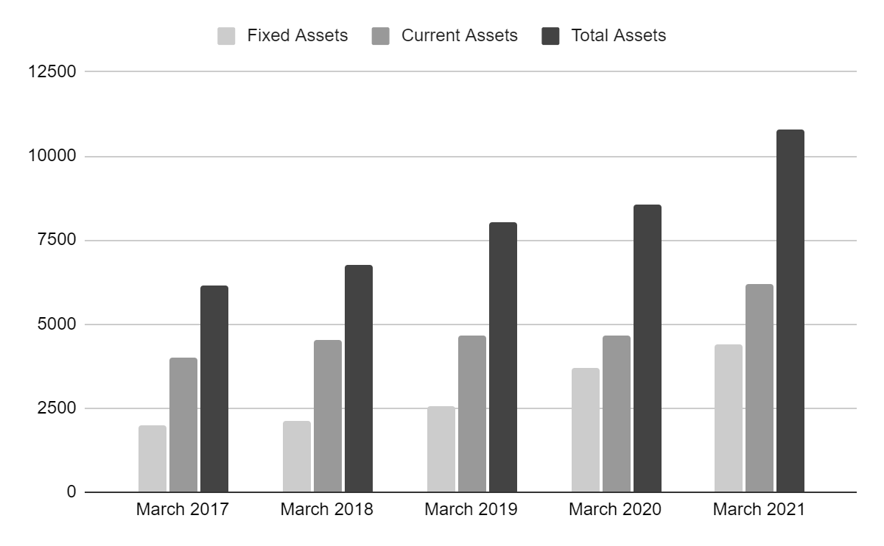
ASSETS

Slide 13
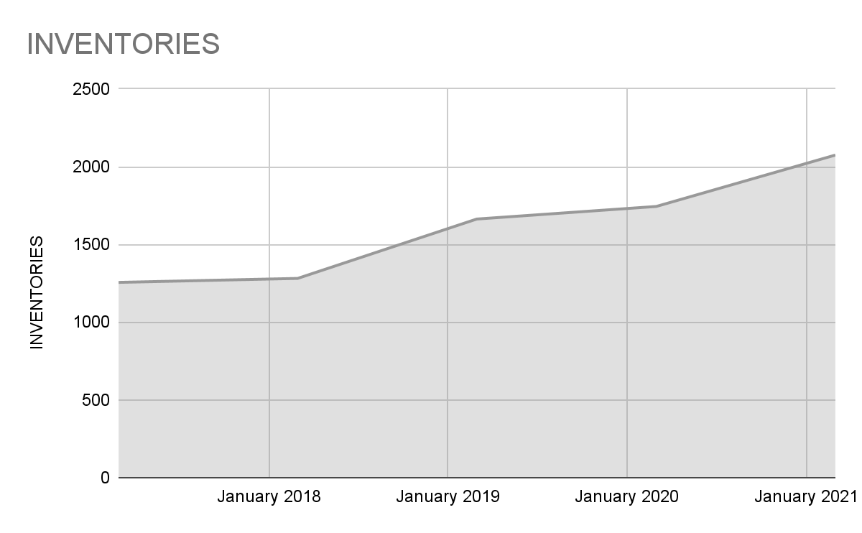
INVENTORIES

Slide 14

03
Cash flow

Slide 15

CASH FLOW
The term cash flow refers to the net amount of cash and cash equivalents being transferred in and out of a company. Cash received represents inflows, while money spent represents outflows.

Slide 16
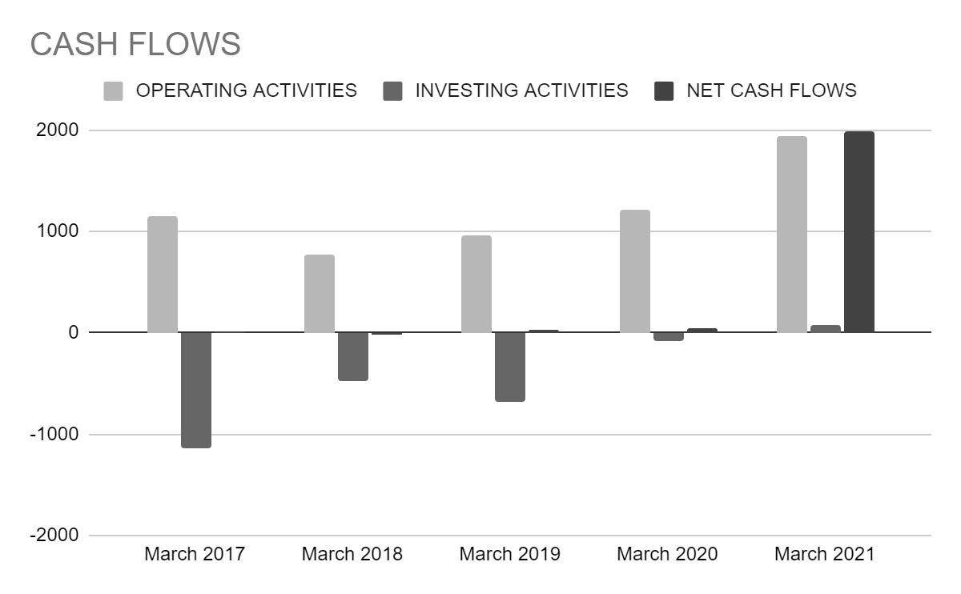
CASH FLOW

Slide 17
04
MARKET CAPITALISATION

Slide 18

MARKET CAPITALISATION
Market capitalization, commonly called market cap, is the market value of a publicly traded company's outstanding shares.

Slide 19
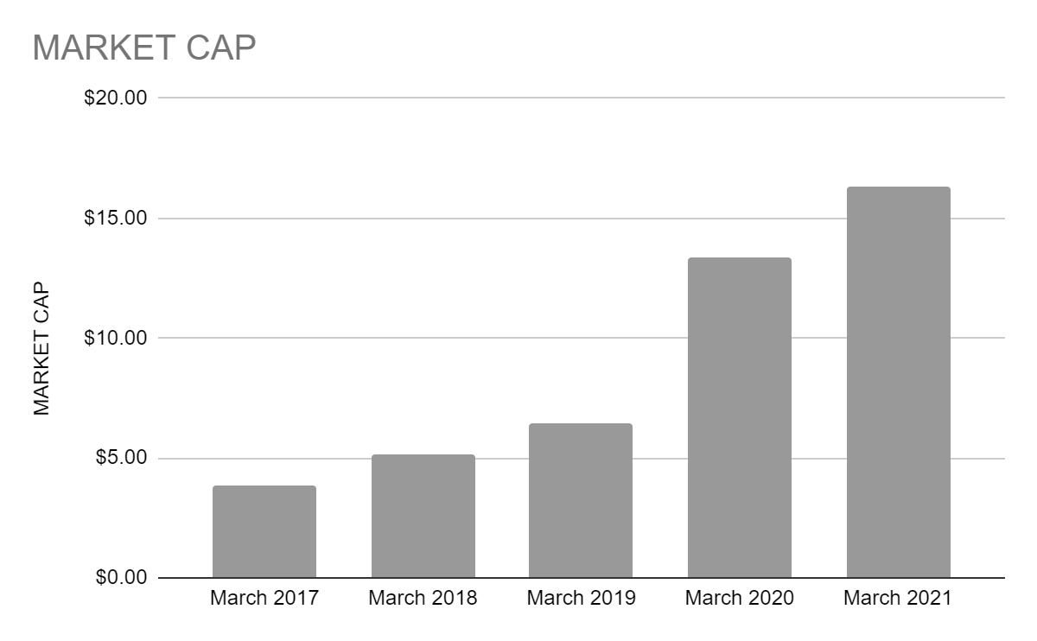
MARKET CAPITAL

Slide 20
Thank You

